Slide 1
Software Engineering CS20006
Lecture 7
Use Case Diagrams

Slide 2
Lecture #7
What is a use-case diagram?
Example: On-line purchase (OLP) system
Use-case diagram of OLP system
Different components in a use-case diagram and their notations
A use-case and its corresponding scenario
How to create a use case diagram?
Use case relationships
Use case packaging

Slide 3
What is a Use Case Diagram?
The use case diagram is a diagram to model the use case view of a system. The behavior of the system under development (i.e., what functionality must be provided by the system) is documented in a use case diagram
Use case diagram illustrates the systems intended functions, its surroundings and relationship between the functions and surroundings
Example:
On-line purchase (OLP) system

Slide 4
On-Line Purchase (OLP) System
Intended functions
Search items
Place order
Process order
Control inventory
Help on-line
Its surroundings
Customer
Manager
Payment processor

Slide 5
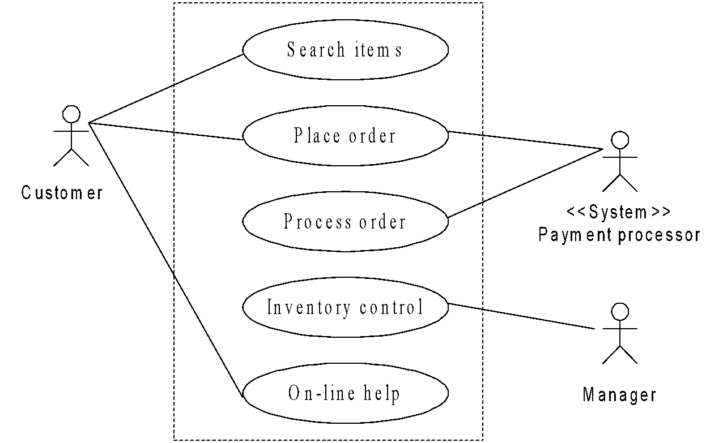
Use Case Diagram of OLP System

Slide 6
Usage of Use Case Diagrams
Use case diagram depicts the desirable functionalities (dynamic aspects) of an information system
Use case diagram very much resembles with the function oriented concepts (functional decomposition) of a system
Use case diagram is considered as the central part of the system model and provides vehicle used by the customer (or end users) and the developer discuss the system’s functionality and the behavior

Slide 7
Different Components in the Use Case Diagram
Basic components in a use case diagram are
Use cases
Actors
Associations
System boundary boxes (optional)
Packages (optional)

Slide 8
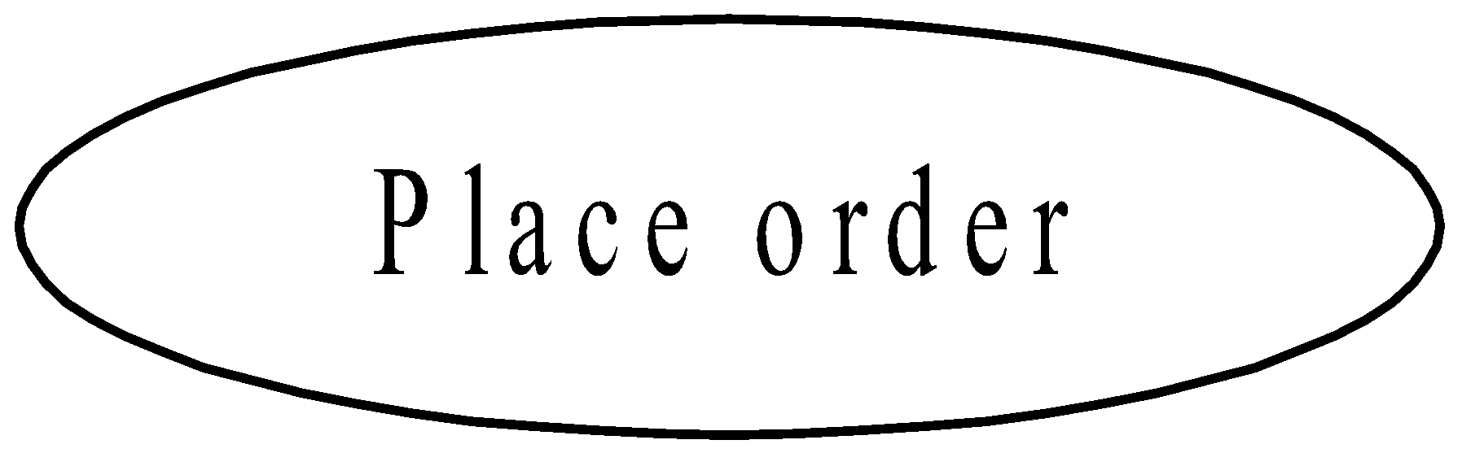
Use Case in Use Case Diagram
Use case
A use case describes a functionality provided by the system. The collection of use-cases for a system constitute all the defined ways the system may be used
Formal definition
A use case is a sequence of transactions performed by the system that yields a measurable result of values for a particular user (actor)
Notation: A use case is represented by an oval

Slide 9

Actor in Use Case Diagram
Actor
An actor is a person, organization, or external system that plays a role in one or more interaction with the system
Note: Actors are not part of the system; they represent any one or any thing that interact with the system
Notation: Actor can be represented as a stick man

Slide 10
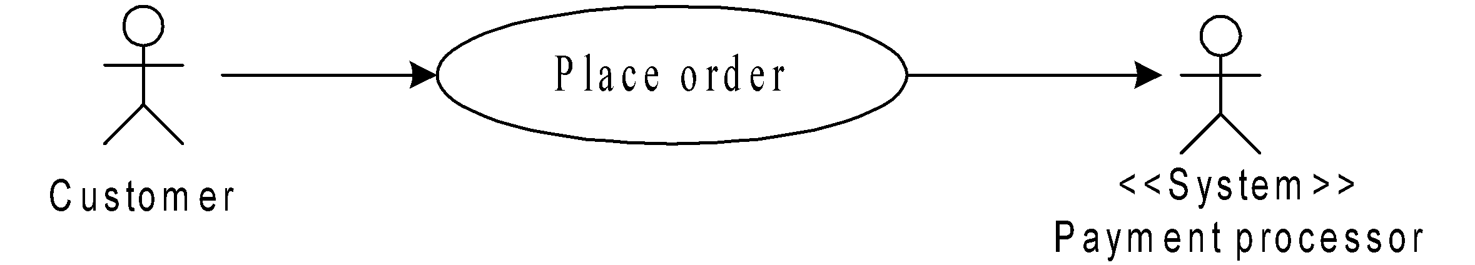
Association in Use Case Diagram
Association
Associations between actors and use cases are indicated in use case diagrams by solid lines. An association exists whenever actor involved with an interaction described by the use case
Associations are modeled as lines connecting use cases and actor to one another, with optional arrowhead on one end of the line. The arrowhead is used to indicating the direction of the relationship or to indicate the primary actor within the use case
Notation

Slide 11
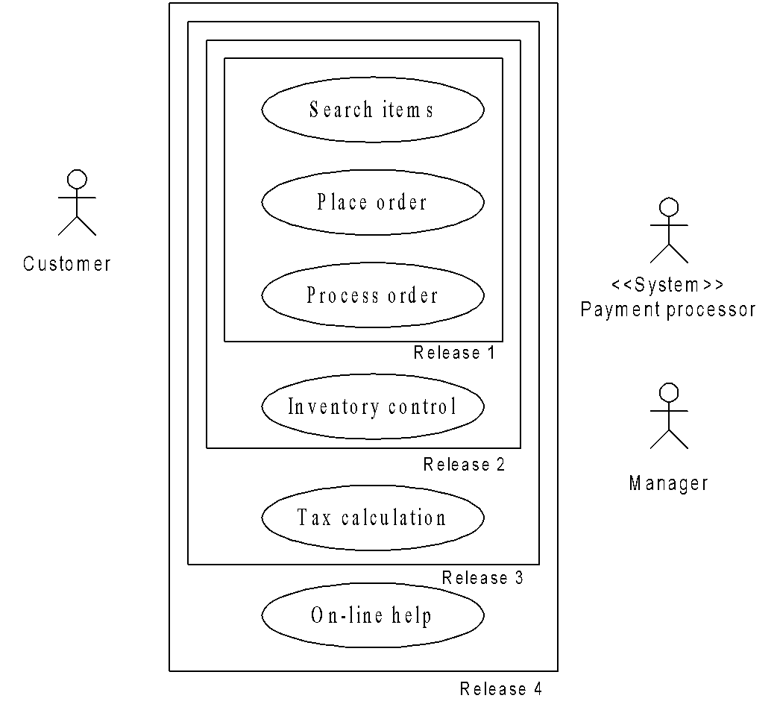
System Boundary Box in Use Case Diagram
System boundary boxes
It is an optional thing in a use case diagram to draw a rectangle around the use cases and to indicate the scope of the system
Notation

Slide 12
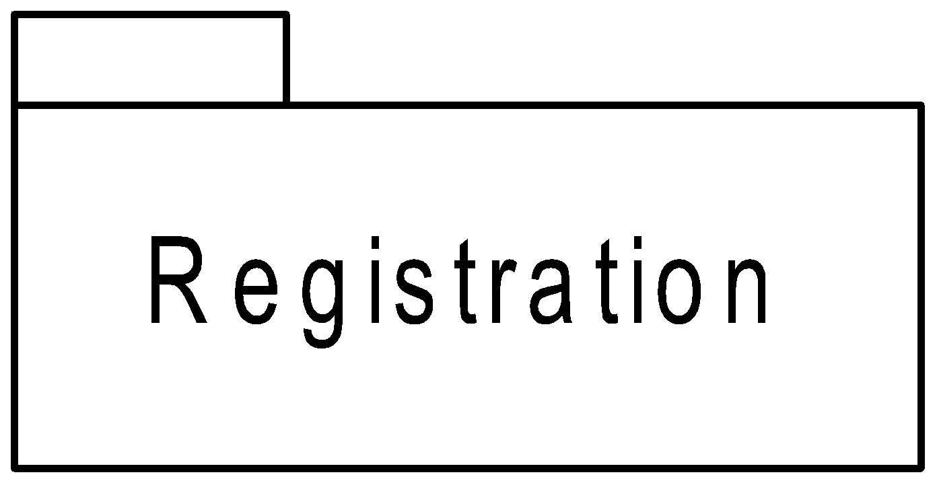
Packages in Use Case Diagram
Packages
Packages enable to organize model elements into groups
Notation
Packages are depicted as a file folders and can be used on any of the UML diagrams, including both use case diagrams, class diagrams etc.
Note: Usually package can be used when a UML diagram is quite large and can not be accommodated on a single page, or organize a large diagram into smaller ones

Slide 13
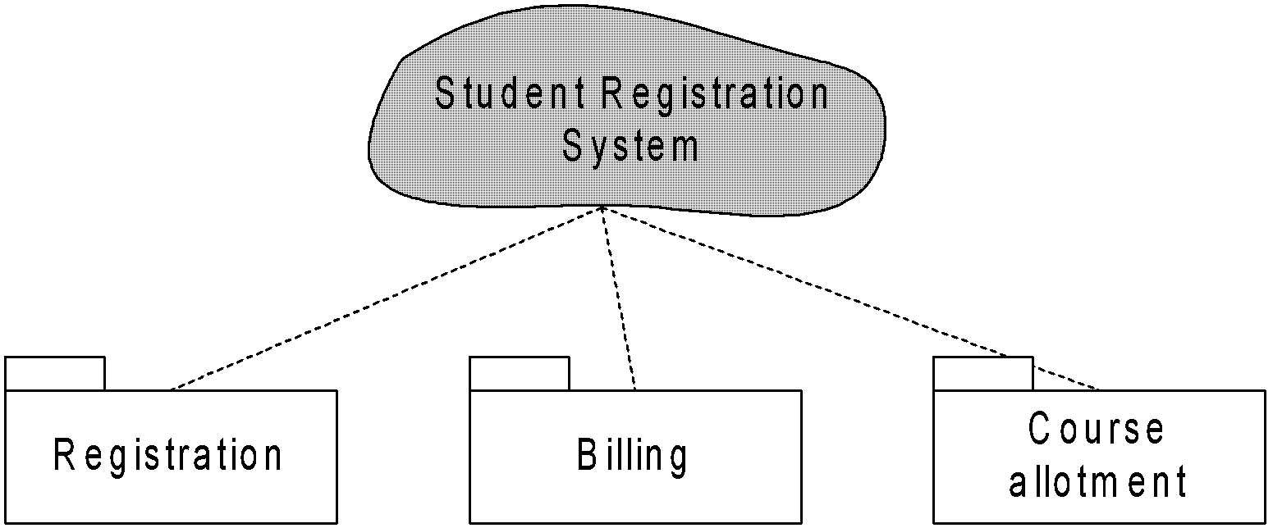
Packages in Use Case Diagram
Example

Slide 14
Scenario and Use Case
Scenario
A scenario is a sequence of steps describing an interaction between a user and system
Corresponding to a use case, there is a number of scenarios. All scenario are described by means of a textual description or other artifacts

Slide 15
Example: Scenario and Use Case
Example: In OLP system
Some scenarios are
Customer browses though a catalog and select the items
Customer options for check out
Customer fills shipping information ( address, date of delivery, email, etc.)
System present full pricing information, date of delivery, etc.
Customer fills credit card information
System authorizes purchase
System confirms sales immediately
System confirm sale by sending email by customer
Note: From one scenario, another scenario can arise. For example: at 3 incomplete information, at 6 authorization fails etc.

Slide 16
How to Create a Use Case Diagram?
Three steps
Identify all actors
Identify all use cases
All associations between actors and use cases
Study carefully the requirement analysis and specification (SRS) to identify all these

Slide 17
Identifying all Actors
The following questions may be used to help identify the actors for a system
Who will use the system?
Where in the organization in the system used?
Who will supply, use, update the information in the system?
Who will support and maintain the system?
Does the system use external resource?
Does one person play several roles?
Does several persons play several roles ?
….. etc.

Slide 18
Identifying all Use Cases
The following questions may be used to help identify the actors for a system
What are the functional requirements?
What are the tasks of each actor?
Will any actor create, change, store, remove, or read information in the system?
What use case will accomplish the actors requirements?
….etc.

Slide 19
Identifying all Associations
There will be an association between an actor and a use case, if there is
any correspondence/communication between the two
information storing/updating
….etc.

Slide 20
Use Case Relationships
In addition to association relationship ( which may exist between an actor and use-case) to represents a communication between an actor and a use-case, there are other three types of relationships may exist between use-cases
Include
Extend
Generalization

Slide 21
Include Relationship
A use case in UML is same as the function in structured design
Like structured design, a use case can be decomposed into sub use cases
Include
To represent that a use case is composed of (reuse)

Slide 22
Include Relationship
Further
Multiple use cases may share a piece of some common functionality. This functionality is placed in a separate use case rather than documenting it in every use case that needs it
Include relationships are created between the new use case and any other use case that “uses” its functionality

Slide 23
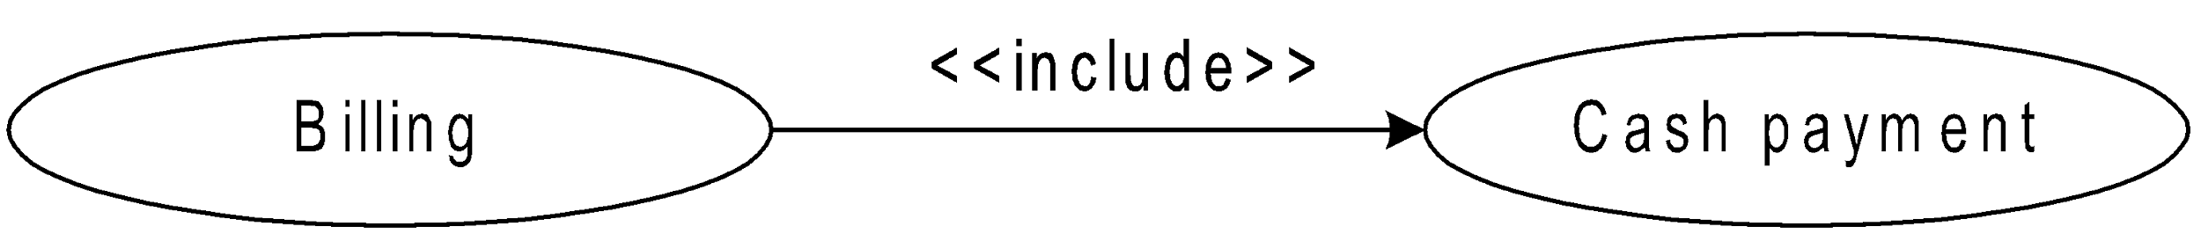
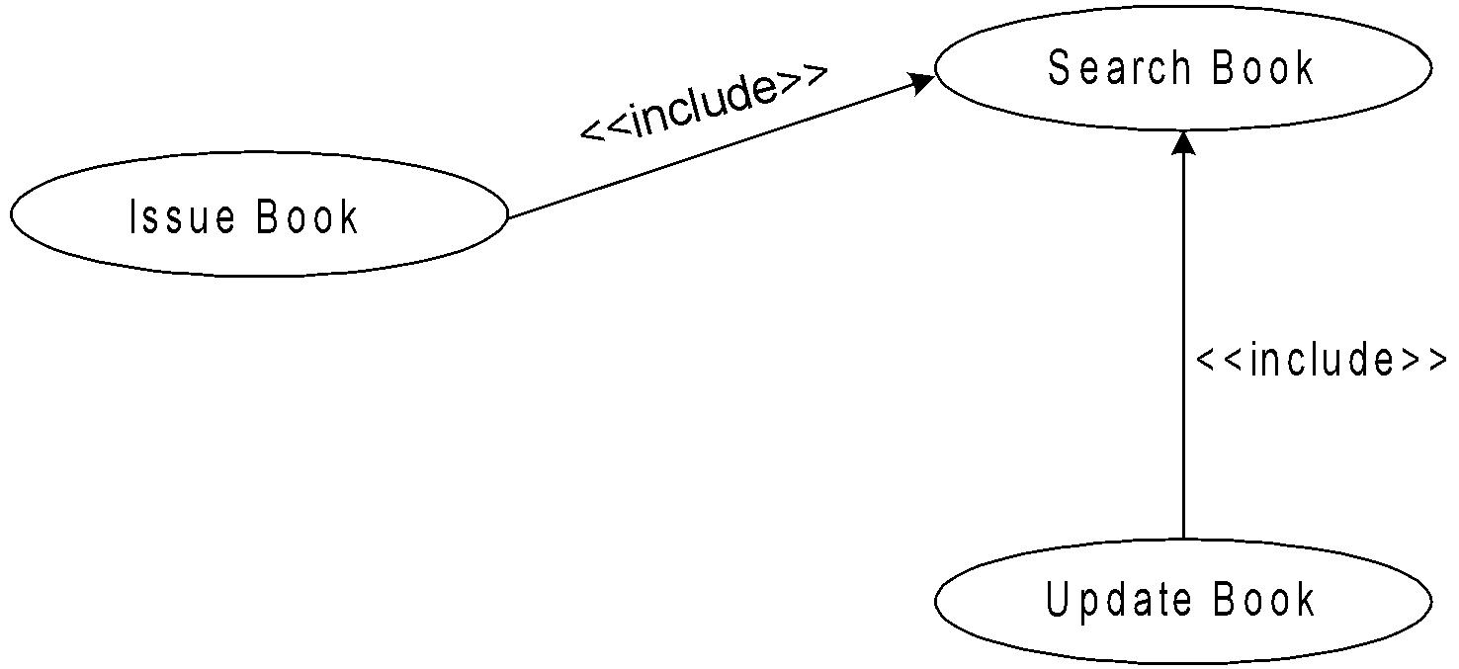
Example: Include Relationship

Slide 24
Extend Relationship
The extended relationship is used to describe a variation on normal behavior and one wish to use the more controlled form. Usually extended relationship is considered to depict the following situations
Optional behavior
Behavior that run only under certain consideration
Several control flows may be run based on actor selection

Slide 25
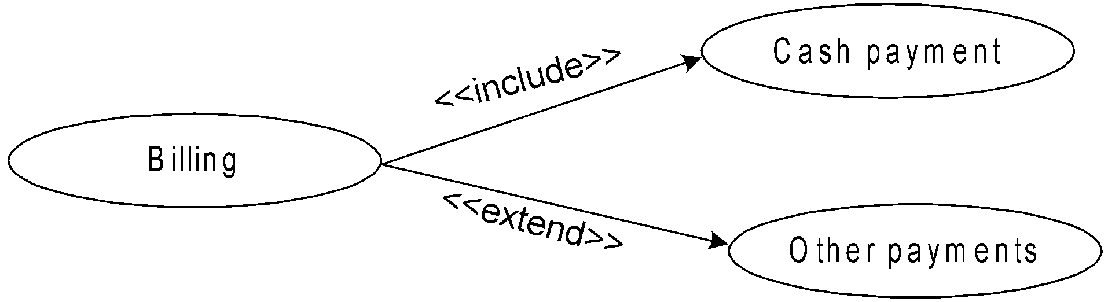
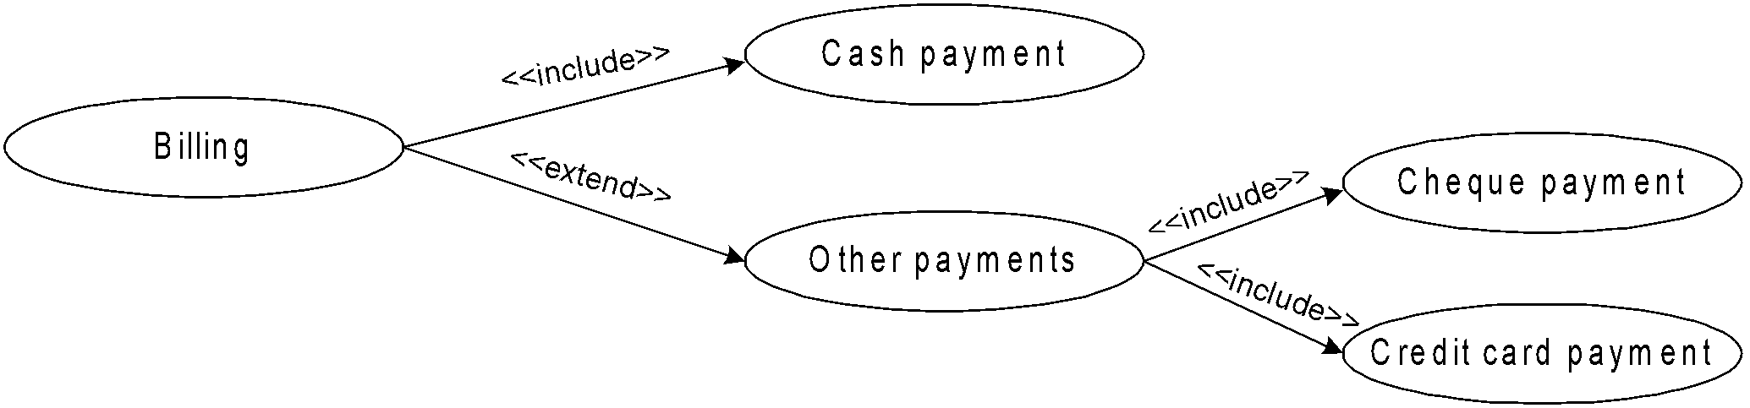
Example: Extend Relationship

Slide 26
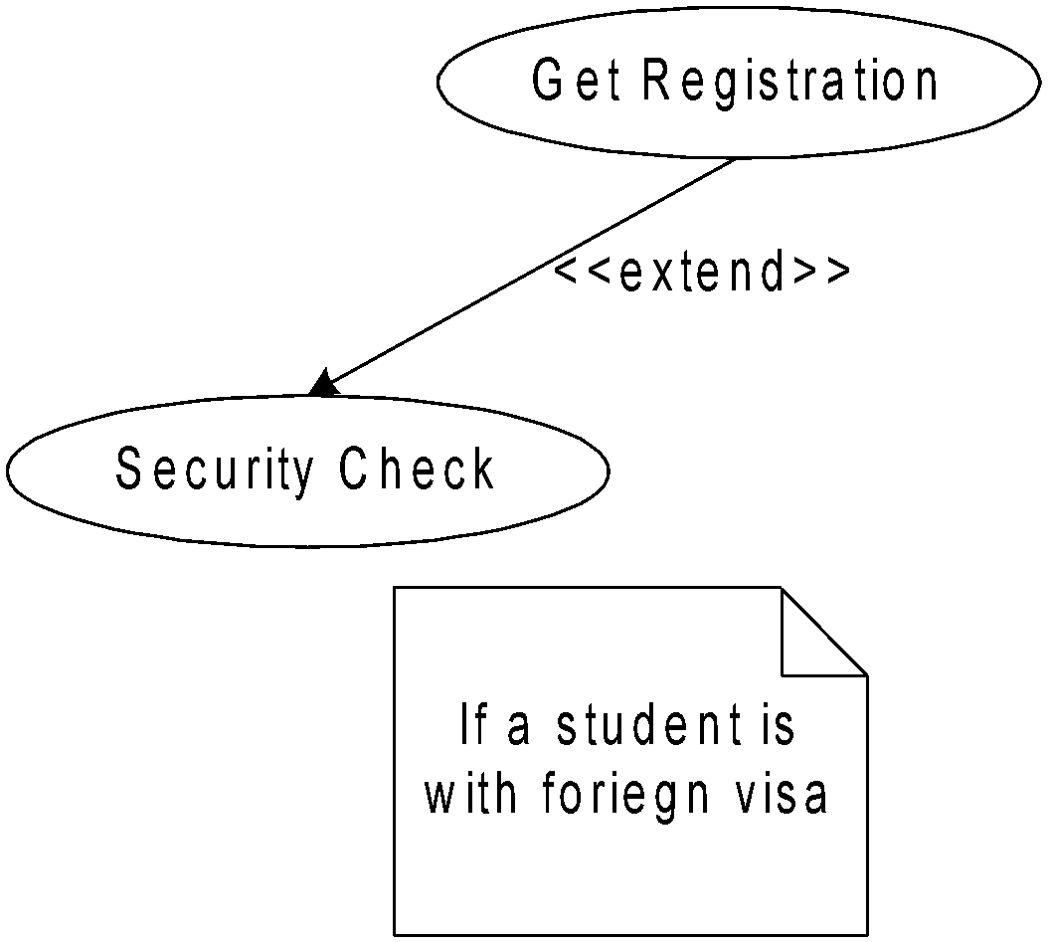
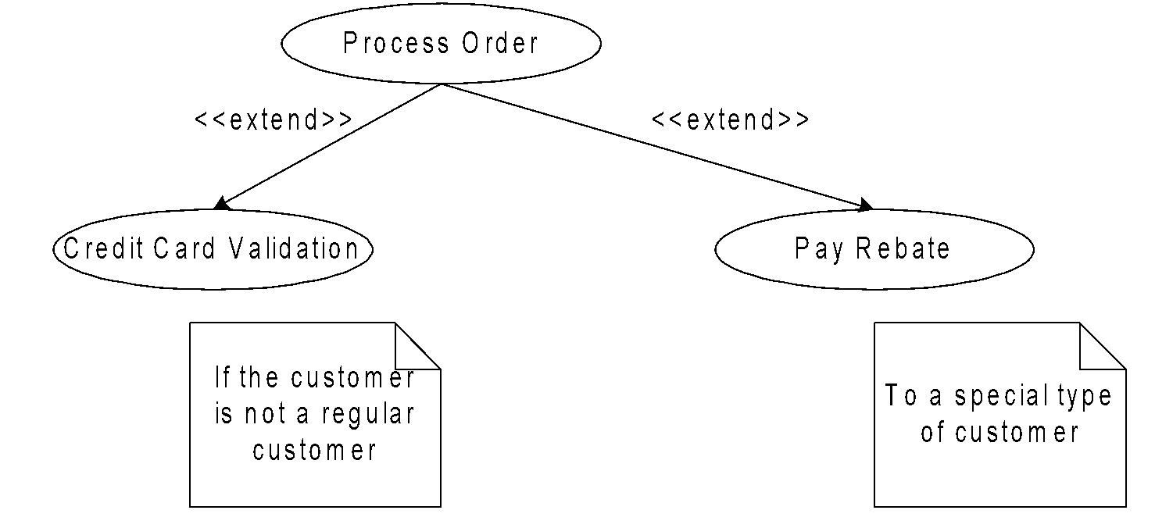
Example: Extend Relationship

Slide 27
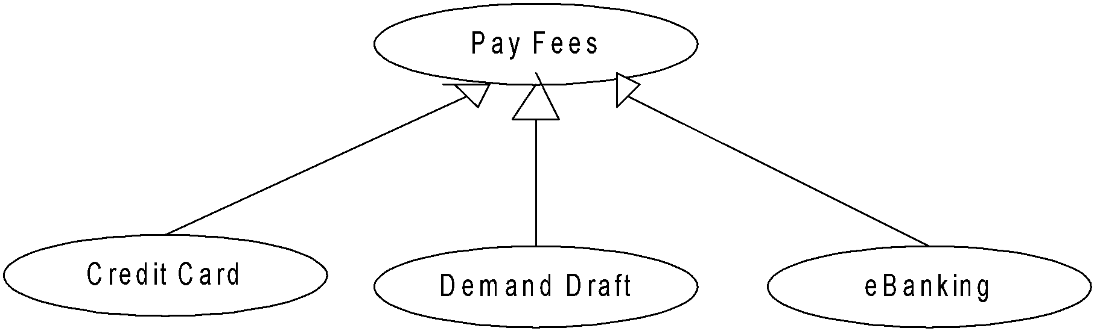
Generalization Relationship
Generalization relationship is very similar to the inheritance relationship as in classes
Inheritance relationship is used to model generalization/ specialization of use case or actors

Slide 28
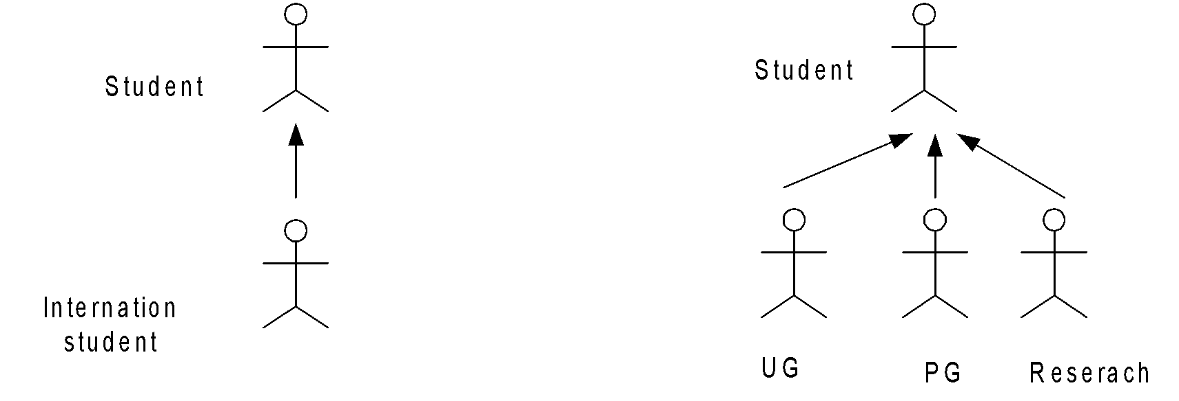
Generalization Relationship
The generalization relationship can also be extended to actor

Slide 29
Use Case Packaging
Packaging is the mechanism in UML to manage complexity
When there are too many use cases in the use case diagram, it is better to package the related use cases so that it can be better documented

Slide 30
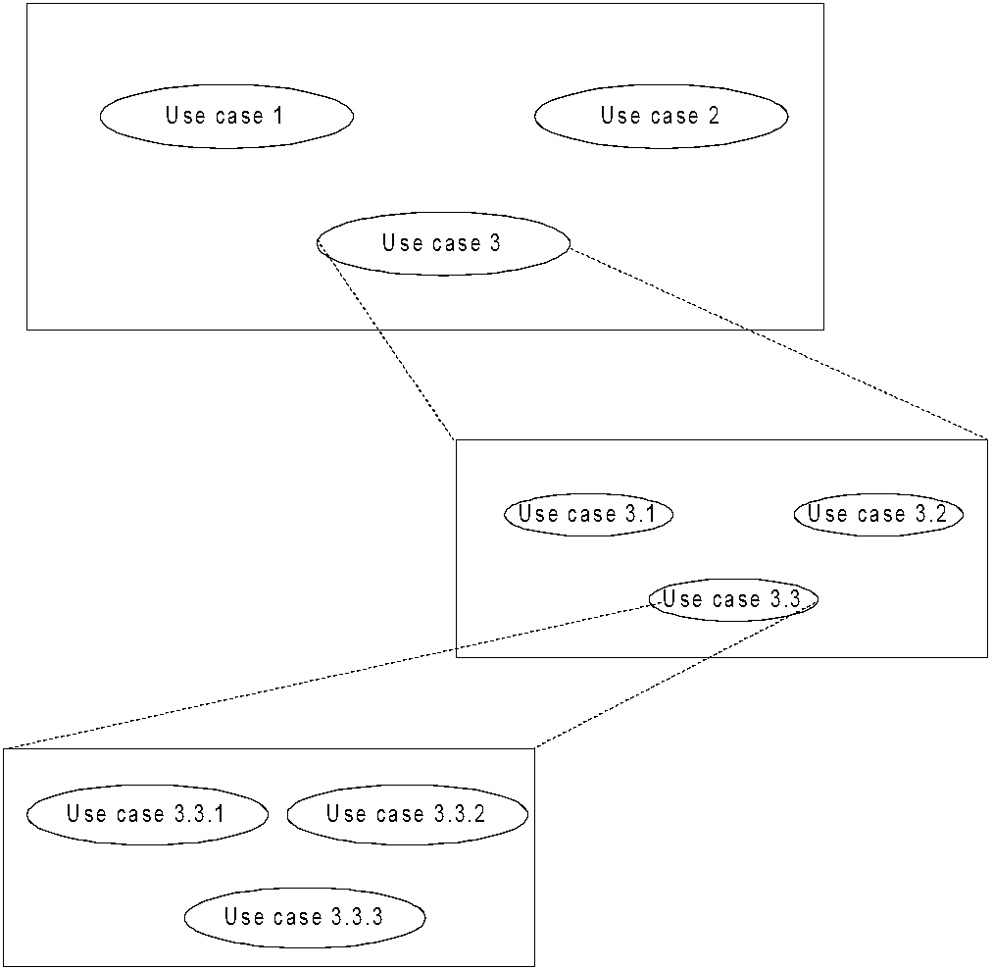
Example: Use Case Packaging

Slide 31
Problems to Ponder
Draw the use case diagram for
Library Information System
Bank ATM

